Slide 1
Data Visualization

Slide 2
Learning Objectives
Bar Plot
Pie Chart
Line Chart
Combination Chart
Scatter Plot
Pivot Charts
Radar Chart
2

Slide 3
Bar Plot in Excel
It is used when we have one categorical data and one numerical data.
Generally, frequency is used as numerical data.
For Adding labels hit “Add Chart Element ” button in the top left corner.
For Changing colors of the bar hit “Change colors.”
Different types of charts in Bar chart can be selected from the options menu.
Side by side column chart are also useful for comparative analysis.

Slide 4
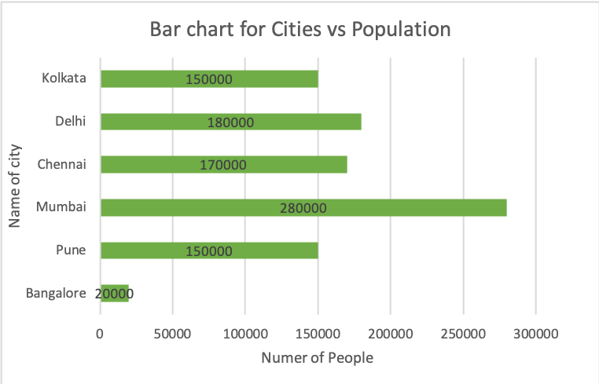
Bar Plot in Excel

Slide 5
Pie Chart in Excel
It is used when we have one categorical data and one numerical data.
Generally, frequency is used as a categorical data.
Pie Charts are convenient to get idea of overall distribution out of 100%
For Adding labels hit “Add Chart Element ” button in the top left corner.
For Changing colors of the particular segment hit the section twice and then edit.
Different types of charts in pie chart can be selected from the options menu.

Slide 6
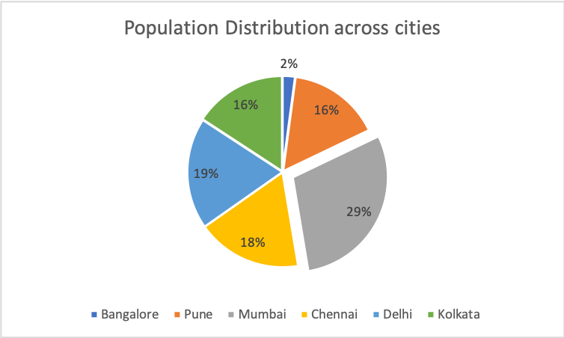
Pie Chart in Excel

Slide 7
Line Chart in Excel
Line charts are used to display if you have text labels, dates or a few numeric labels on the horizontal axis.
Generally, Date is used as a categorical data.
For Adding labels hit “Add Chart Element ” button in the top left corner.
For Changing colors of the Line hit “Change colors.”
Different types of charts in Line chart can be select from the options menu.
Multiple line chart are also useful for comparative analysis.

Slide 8
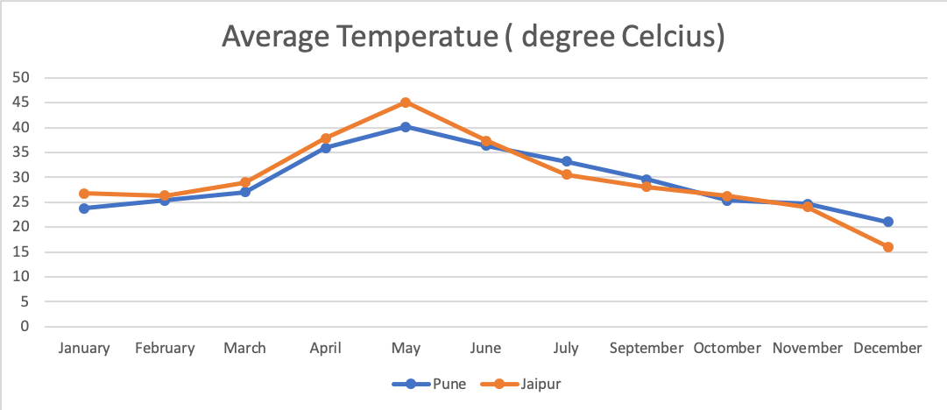
Line Chart in Excel

Slide 9
Combination Chart in Excel
A combination chart is a chart that combines two or more chart types in a single chart.
Here we have created a combination chart for Bar graph and line graph.
For Adding labels hit “Add Chart Element ” button in the top left corner.
For Changing colors of the Line hit “Change colors.”

Slide 10
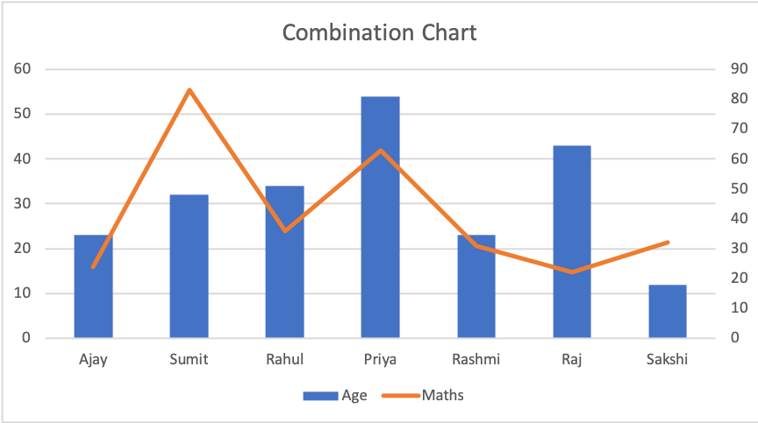
Combination Chart in Excel

Slide 11
Scatter Plot in Excel
It is often used to show the relationship between two numerical parameters.
Linear line can also be drawn in scatter chart from “Add Chart Element” menu.
For Adding labels hit “Add Chart Element ” button in the top left corner.
For Changing colors of the Line hit “Change colors.”
Different types of charts in scatter chart can be select from the options menu.

Slide 12
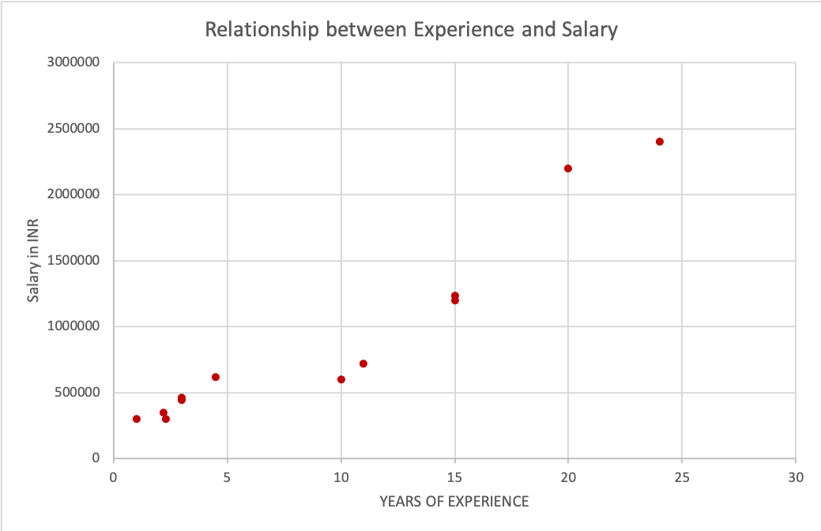
Line Chart in Excel

Slide 13
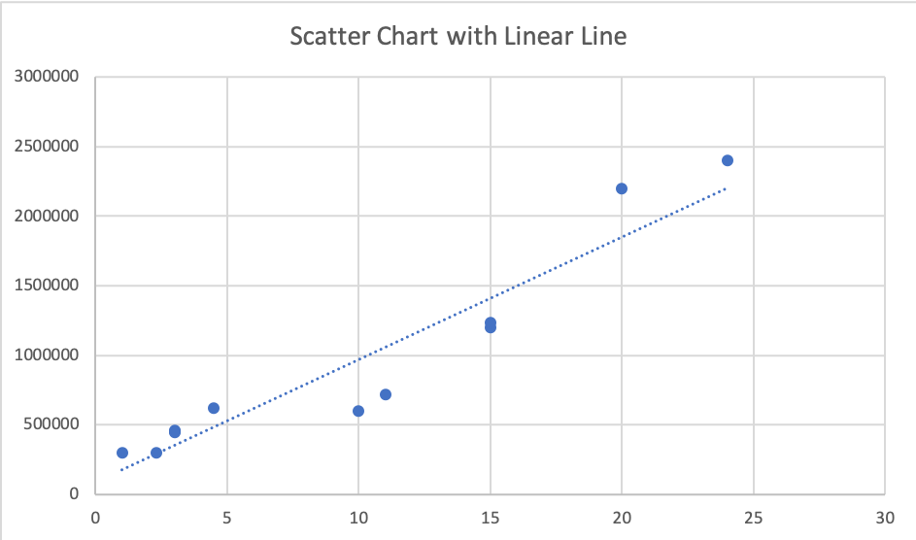
Line Chart in Excel

Slide 14
Pivot Charts in Excel
Pivot Charts are use to analyse the data with in Pivot table.
Steps to get pivot chart are :
Click any cell of pivot table
Go to PivotTable Analysis
Hit Pivot Chart button
Hit graphs elements to make changes in the graph.

Slide 15
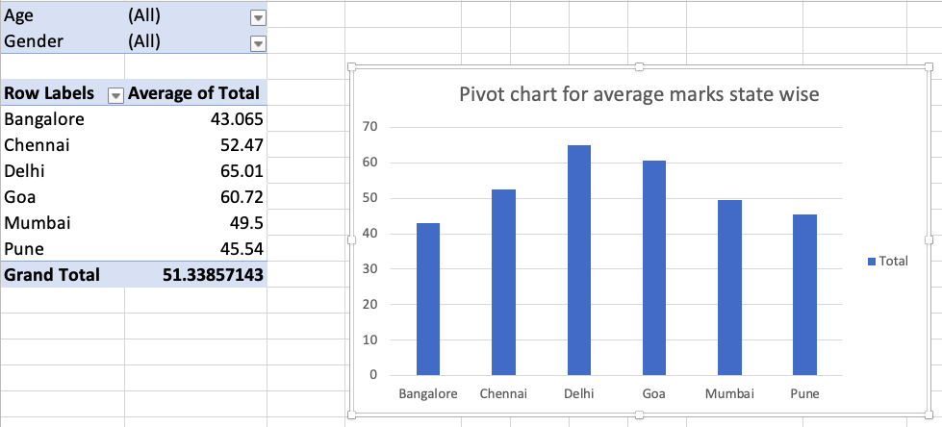
Pivot Charts in Excel

Slide 16
Radar Chart in Excel
Radar Chart is one of the chat use to have clear picture when you want to analyze multiple numerical parameters with respect to categorical feature.

Slide 17
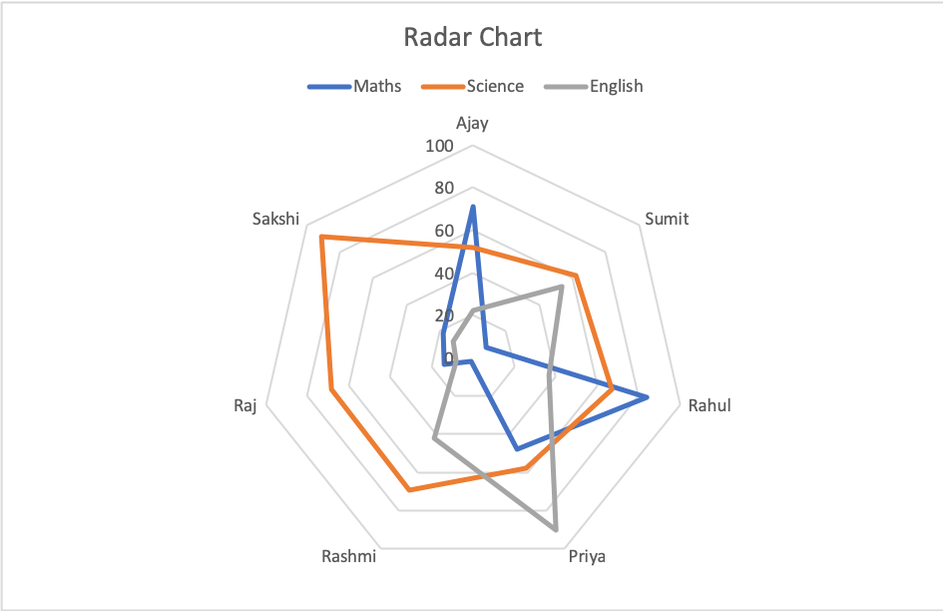
Radar Chart in Excel

Slide 18
The End

